Slide 1

Energy system modelling using OSeMOSYS
LECTURE 3
NAMING CONVENTION AND TIME REPRESENTATION

Slide 2
Learning Outcomes
By the end of this lecture, you will be able to:
ILO 1: Learn how to use generic model naming conventions
ILO 2: Understand the variability of aspects in energy systems
ILO 3: Learn how to represent time in an energy system model using MUIO and OSeMOSYS
2
Notes:
Welcome to Lecture 3 of this course. This lecture focuses on several important concepts including:
Generic model naming conventions
Variability in energy systems
Time representation

Slide 3

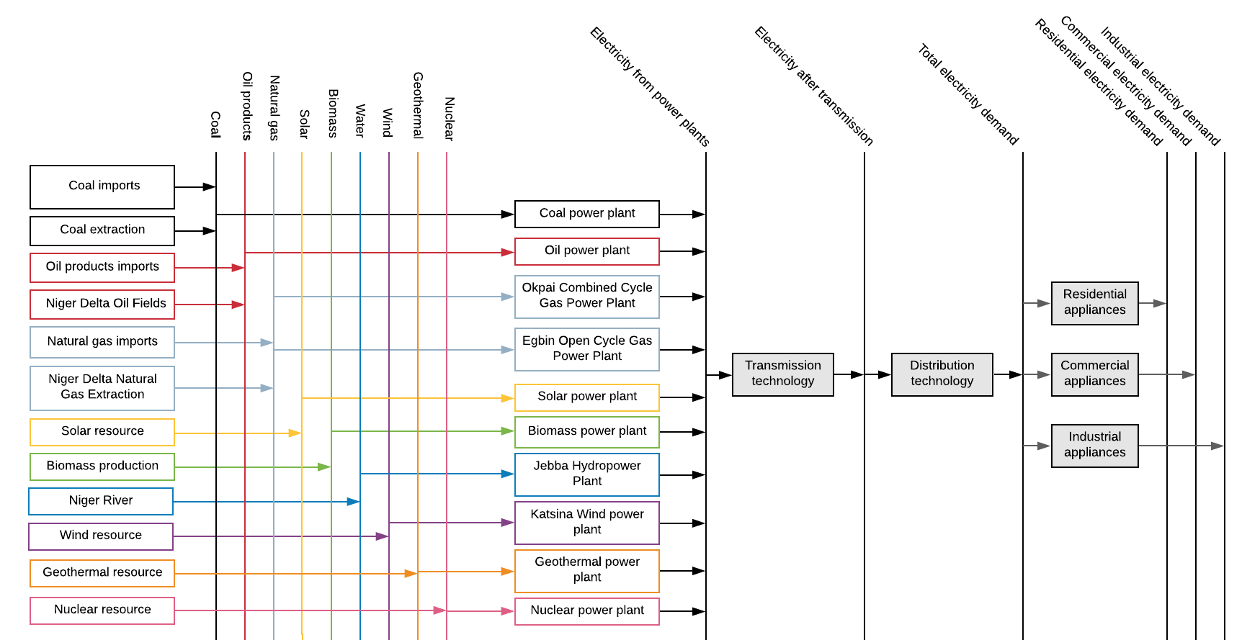
3.1 Naming Convention
3.1.1 Importance of Generic Naming
3
Notes:
This diagram shows an example Reference Energy System constructed for Nigeria. Here we can see total electricity demand divided into the residential, commercial, and industrial sectors, as well as all the technologies that could meet those demands. Since we want to consider all technologies that may become available in the future, the diagram includes power plant types that are not currently active in Nigeria, such as biomass power plants.
In this Reference Energy System, technologies have been given specific names that are relevant to Nigeria, for example Katsina Wind Power Plant is named, rather than using a generic term for all wind power plants. While this may make sense to somebody with knowledge of the Nigerian power system, using specific names can make it harder for other people to identify technologies and understand all of the components in a Reference Energy System. For this reason, we will use a generic naming convention when creating our Reference Energy Systems. This has other benefits, which are explained later.

Slide 4
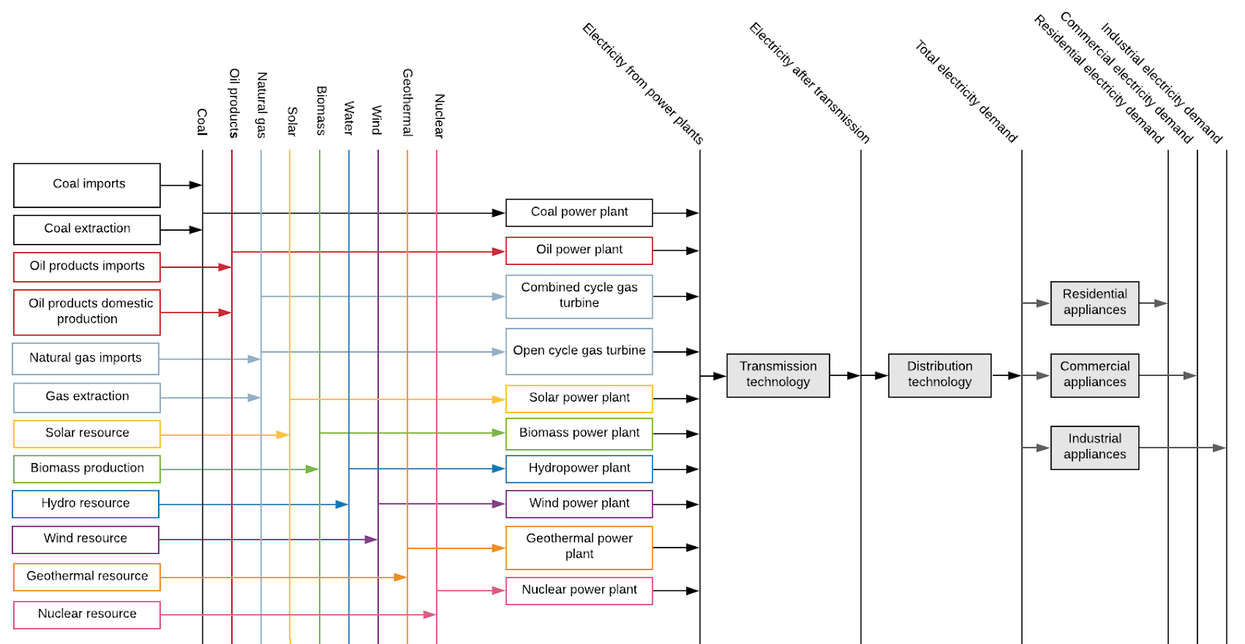
3.1 Naming Convention
3.1.2 Importance of Code Names
4
Notes:
We can now see that all of the specific names in the Reference Energy System diagram have been replaced with generic names. This means that the diagram can now be easily understood by all users, with no confusion over specific power plant names. The use of generic naming also means that technologies can be identified quickly and easily. However, these names are too long to be used in our modelling system, and so short standard codes are used, as explained next.

Slide 5
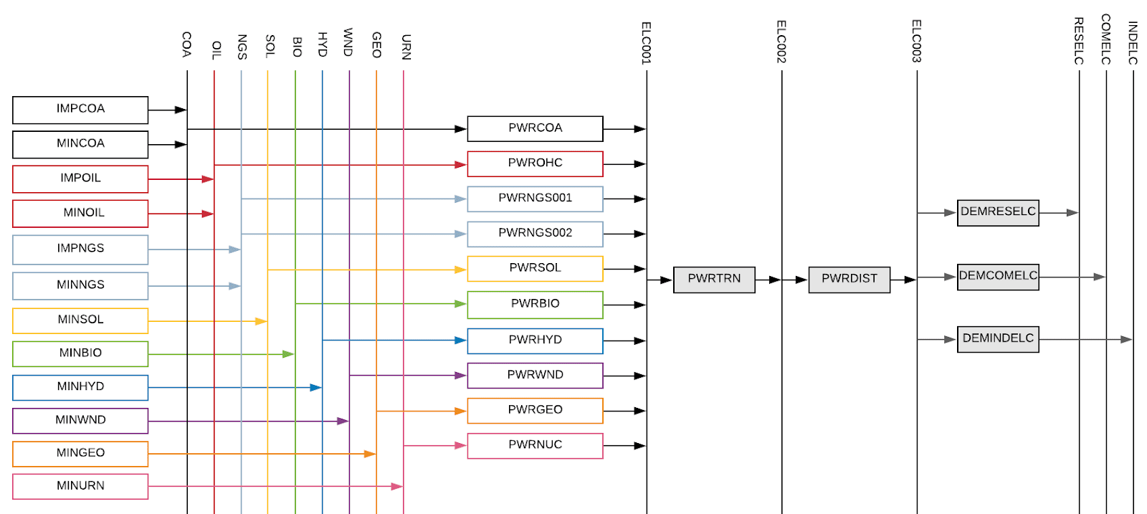
3.1 Naming Convention
3.1.3 Why use a naming convention?
5
Notes:
In this version of the Reference Energy System, technologies and commodities are names using short standard codes. These codes are generated using a standard naming convention, the structure of which is explained in the remaining part of this mini-lecture. It is important to bear in mind that this is not the only naming convention that can be used for OSeMOSYS. The convention is up to the user. However, it is essential that the user stays consist with the naming convention they use. There are two common naming conventions for OSeMOSYS that will be described in the upcoming slides. It is advised for users to use one of the two suggested to make it easily comparable with existing models.
The use of a standard naming convention like this is advantageous because it:
Allows quick and easy technology identification
Is easily replicable
Facilitates comprehension of model components and structure
Allows for structuring data in the model and results during post-processing

Slide 6
3.1 Naming Convention
3.1.4 OSeMOSYS Naming Convention Example 1
DEMRESCKNNGS001
Sector/Category
Examples:
DEM=Demand
PWR=Power
MIN=Mining
IMP=Imports
UPS=Upstream
Subsector
Examples:
RES=Residential
IND=Industry
TRA=Transport
COM=Commercial
Energy service
Examples:
CKN= Cooking
CAR= Car transport demand
HET=heating
Input fuel
Examples:
NGS= Natural gas
BIO= Biomass
ELC= Electricity
Number
Identifier for different types of a same technology
Q: What technology is represented in the example?
6
Notes:
An example of a common structure of the generic convention for naming technologies is shown in this figure. The technology name is composed of five segments: the first identifies the category of the technology, the second identifies the subsector if applicable, then the third identifies energy service or demand being produced if applicable, and the fourth is the fuel or commodity it uses. Each segment is made up of 3 letters which identify the term. The technology name therefore has 6 or 12 letters in total, depending on whether it is assigned a subsector or an energy service. For example, a coal power plant can be named PWRCOA: PWR identifies the category as the power generation, and COA identifies that the commodity used by this technology is Coal. If there is more than one type of a technology, a 3-digit number at the end is used to distinguish between types e.g. PWRCOA001 would be Coal Power Plant type 1 and PWRCOA002 would be Coal Power Plant type 2. A: The example on the slide represents a natural gas stove in the residential sector. Disclaimer: The naming convention can be whatever you define it to be but it is important that you stay consistent with one type of naming convention.

Slide 7
3.1 Naming Convention
3.1.5 OSeMOSYS Naming Convention Example 1
Examples of commodities as final demands
TRACAR=Car transport demand
RESELC=Electricity demand in the residential sector
COMHET=Heat demand in the commercial sector
INDHHT=High heat demand in the industrial sector
AGRDSL=Diesel demand in the agriculture sector
Additional examples of commodities/fuels
SOL=Solar energy
WND=Wind energy
HYD=Hydro energy
GEO=Geothermal energy
COA=Coal
CRU=Crude oil
BAG=Bagasse
LPG=Liquified Petroleum Gas
DSL=Diesel
GSL=Gasoline
FOL=Fuel oil
JET=Jet fuel
HDG=Hydrogen
7
Notes:
Commodities or fuels are assigned 3- or 6-letter names, as illustrated in some examples on this slide. For sector-specific commodities, particularly final demands, the first three letters of the name represent the subsector, while the second three letters indicate the energy service. For instance, diesel used in the transport sector would be labeled as TRADSL. Commodities or fuels associated with primary sources or transformation processes are generally represented using only three letters. It's important to note that energy services or final demands are also modelled as commodities within OSeMOSYS.

Slide 8
3.1 Naming Convention
3.1.6 OSeMOSYS Naming Convention Example 2
PHL_AGR_HEAT_BIOM
Country Code
Examples: PHL = Phillipinnes
NAM = Namibia
DOM = Dominican Republic
LAO = Lao
MUS = Mauritius
Subsector
Examples:
AGR = Agriculture
IND=Industry
TRA=Transport SER = Services
Service
Examples:
HEAT=Heating
CKN = Cooking
TRUH = Heavy trucks
Input fuel/Output Commodity
Examples:
BIOM= Biomass
NG = Natural Gas
ELE= Electricity
MAI = Maize
Q: What technology is represented in this example?
Notes:
Another commonly used naming convention in OSeMOSYS is the one seen above. The technology name is typically composed of four to five segments: the first segment identifies the country the technology specific to; this is typically a three-letter standard code used in international databases to define countries. The second segment represents each sub-sector. Energy supply is POW, Transport is TRA, Industry is IND, Buildings can be HOU for housing or SER for services, Land is LND, Agriculture for crops and livestock is AGR, Waste is WST and so on. The third segment is the service which can be heating (HEAT), low temperature heating (LPH), high temperature heating (HPH), cars (CAR) and many more. The fourth segment is the type of fuel biomass (BIOM), Coal (COAL), Natural Gas (NG), Hydrogen (H2), Electricity (ELE), oil (OIL) and more. The fifth segment is typically only used to represent whether a technology is using Carbon Capture Storage (CCS) or if there are more than one type of the same technology (for example the same technology but in different regions). It would be an additional segment as follows TUR_AGR_HEAT_BIOM_CCS or TUR_POW_PP_SPV_T1 respectively (energy supply power plant solar photovoltaic tier 1 – which is just region 1, you could then have T2, T3 etc.) A: Philippines Agriculture Heating using Biomass

Slide 9
3.1 Naming Convention
3.1.7 OSeMOSYS Naming Convention Example 2
Examples of commodities as final demands
PHL_TRA_PKMC = Philipinnes Car transport demand
PHL_HOU_ELEF = Philipinnes demand in the housing sector
PHL_SER_HEAT = Philipinnes Heat demand in the commercial sector
PHL_INDU_ISHPH =Philipinnes Industry Iron and Steel High Temperature Process Heating
PHL_AGR_MOT_LIQ = Philipinnes Diesel use in the agriculture sector for motive power
Additional examples of fuels
PHIL_PRO_COAL0 =Coal
PHL_PRO_OIL0 =Crude oil
PHL_PRO_BIOF =Biofuel
PHL_PRO_LPG=Liquified Petroleum Gas
PHL_PRO_DSL=Diesel
PHL_PRO_GSL=Gasoline
PHL_POW_H2 =Hydrogen
9
Notes:
Typically, commodities involve three segments. Similar to the technologies this naming convention the first segment is always the country code. The second part of the commodity name typically represents the sector or area the commodity is associated with. PRO represents production for fuels. The final part of the segment will represent the fuel or service the commodity is for.

Slide 10
Lecture 3.1 References
Taliotis, Constantinos, Gardumi, Francesco, Shivakumar, Abhishek, Sridharan, Vignesh, Ramos, Eunice, Beltramo, Agnese, … Howells, Mark. (2018, November). Time representation in OSeMOSYS. Zenodo. http://doi.org/10.5281/zenodo.4585695
10

Slide 11
3.2 Importance of Time Representation
3.2.1 Time Variability in Energy Systems – Annual Variability
Sources of Annual Variability:
Energy Prices
Technology Efficiencies
Technology Costs
Investment and generation constraints
11
Notes:
Time variability is represented in several ways in OSeMOSYS. One key aspect of temporal resolution is that OSeMOSYS solves in 1-year intervals and thus data is added annually.
The figure outlines the main sources of annual variability (this list is not exhaustive) that can influence model outcomes:
1. Energy Prices: Fluctuate year-to-year due to market conditions, fuel availability, and geopolitical factors, impacting cost-effectiveness of technologies. Commodity prices can vary strongly over time due to changes in supply and demand. As a general rule, when the supply of a commodity exceeds the demand, prices fall, and when demand exceeds supply, prices rise. Supply and demand can be influenced by several external factors, such as economic downturns, which reduce demand, or geopolitical events and natural disasters, which can temporarily slow production. We can see the volatility of commodity prices in the figure above. It is important that we consider this variation in commodity prices in energy system models in order to make our models more aligned with reality.
2. Technology Efficiencies: May change over time due to technological improvements or degradation, influencing how much input energy is needed to deliver useful energy.
3. Technology Costs: Investment and operational costs evolve over time as technologies mature, or materials become scarce.
4. Investment and Generation Constraints: Policies, regulations, and system limitations vary across years and can affect what capacity can be added or how existing technologies are used.
In OSeMOSYS, these factors can be specified per year, allowing users to represent long- term trends, scenarios, or shocks even when using a simplified time structure. This supports effective planning as many government reports and strategies are detailed on a yearly basis.

Slide 12
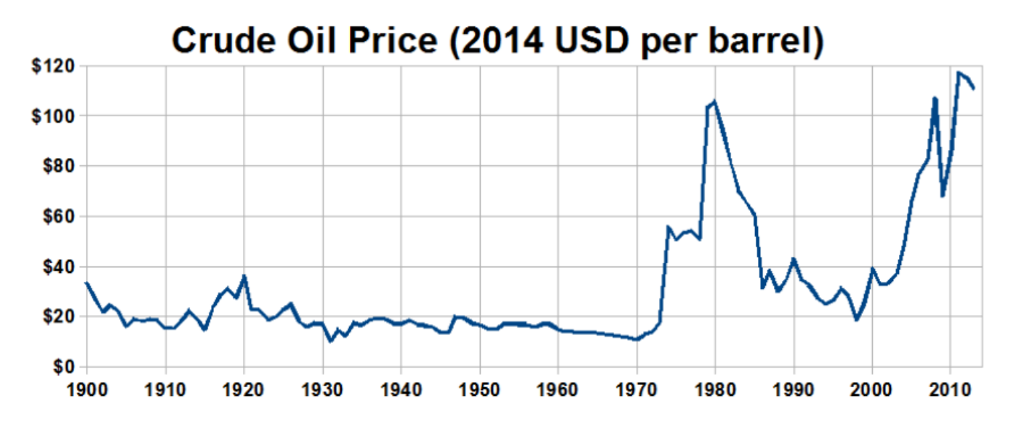
3.2 Importance of Time Representation
3.2.2 Price variability
(Travelplanner, image, licensed under CC BY-SA 3.0)
12
Notes:
The main source of annual variability in energy systems comes from the costs of commodities. Commodity prices can vary strongly over time due to changes in supply and demand. As a general rule, when the supply of a commodity exceeds the demand, prices fall, and when demand exceeds supply, prices rise. Supply and demand can be influenced by several external factors, such as economic downturns, which reduce demand, or geopolitical events and natural disasters, which can temporarily slow production. We can see the volatility of commodity prices in the figure above. It is important that we consider this variation in commodity prices in energy system models in order to make our models more aligned with reality. In OSeMOSYS, this is done by specifying commodity prices in each year of the modelling period based on price forecasts.

Slide 13
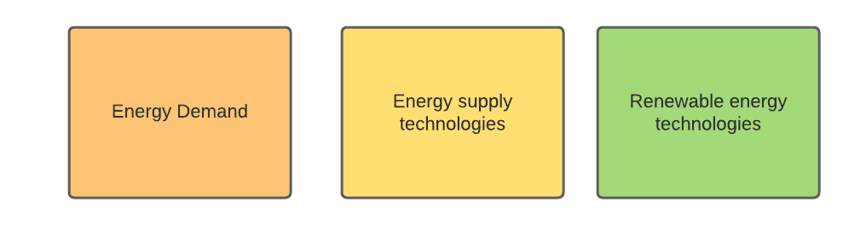
3.2 Importance of Time Representation
3.2.3 Time Variability in Energy Systems – Intra-annual variability
Sources of Time Variability (intra-annual):
13
Notes:
In addition to parameters that vary annually, there are aspects of the energy system that vary within each year (e.g., daily, weekly, or seasonally), on both the demand and supply sides. Therefore, temporal resolution in OSeMOSYS also accounts for these intra-annual segments within each year.
Areas where this temporal variability is present include (but are not limited to):
- Energy demand (for example, cooling demand differs between winter and summer);
- Availability of supply technologies (for example, the availability of certain crops varies throughout the year);
- Availability of resources, such as renewable energy sources (e.g., water availability or solar irradiation), and storage utilization.
Consequently, it is necessary to ensure that sufficient capacity is available to meet demand at all times. This means ensuring that energy services are accessible whenever they are needed.

Slide 14
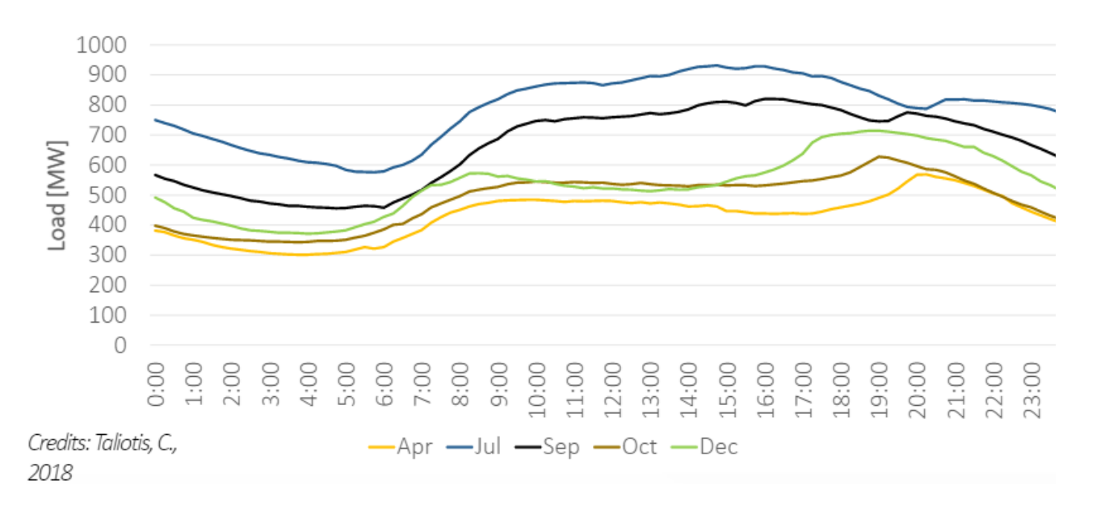
3.2 Importance of Time Representation
3.2.4 Variability of Energy Demand
(Taliotis et al. (2018), image, licensed under CC BY 4.0)
14
Notes:
This is an example of how a demand for a commodity can vary over time. In most cases, electricity demand varies over time. This occurs on several scales. Firstly, electricity demand is rarely constant throughout the day. Demand varies as consumers’ activities occur at different times of the day. For example, in many countries, we see the highest electricity demand in the late afternoon and early evening. This can be when consumers use most power, for example to cook a meal or turn lamps on as it gets dark. Secondly, energy demand is rarely constant throughout the year. Demand changes as the seasons change. For example, in cold countries, residential electricity demand may be higher in the winter than in the summer as consumers use more power for heating and lighting. This diagram shows an example of how electricity demand may vary on both daily and monthly timescales within a country.
It is often important to model these variations in demand over time in order to ensure sufficient energy can be supplied at all times.
Can you think of other demands that vary throughout the day, seasons or years? (e.g. heating demand, cooling demand, crop harvests, airplane travel etc.)

Slide 15
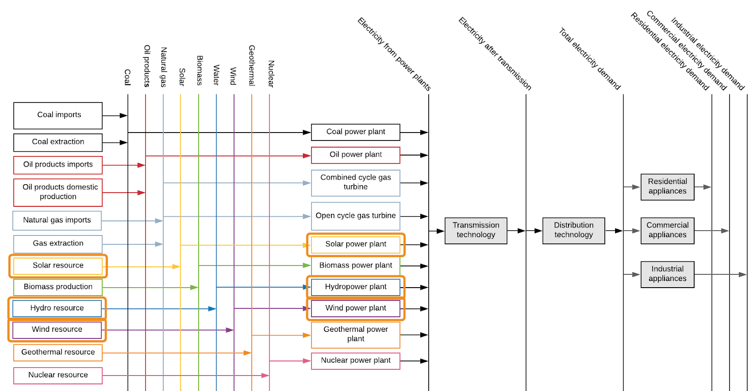
3.2 Additional System Variability
3.2.5 Variability of Renewable Energy Part 1
15
Notes:
So, we have learnt that energy demand varies with time and that this must be considered in energy modelling. Another important consideration is that the availability of renewable energy resources also varies with time. This refers to the fact that the amount of energy available from solar, wind, and hydropower resources is not constant. For example, the amount of solar energy that can be converted to electricity by a solar PV panel is dependent on the strength of the sunlight (otherwise known as solar irradiance). Since it is often sunniest in the middle of the day and dark at night, a solar PV panel can therefore produce most electricity in the middle of the day and no electricity at night. Renewable energy availability will also vary by season, as the strength of the sunlight, wind conditions, and water flow all vary throughout the year. To ensure electricity systems are reliable and capable of meeting demand, it is important to model this variability.

Slide 16
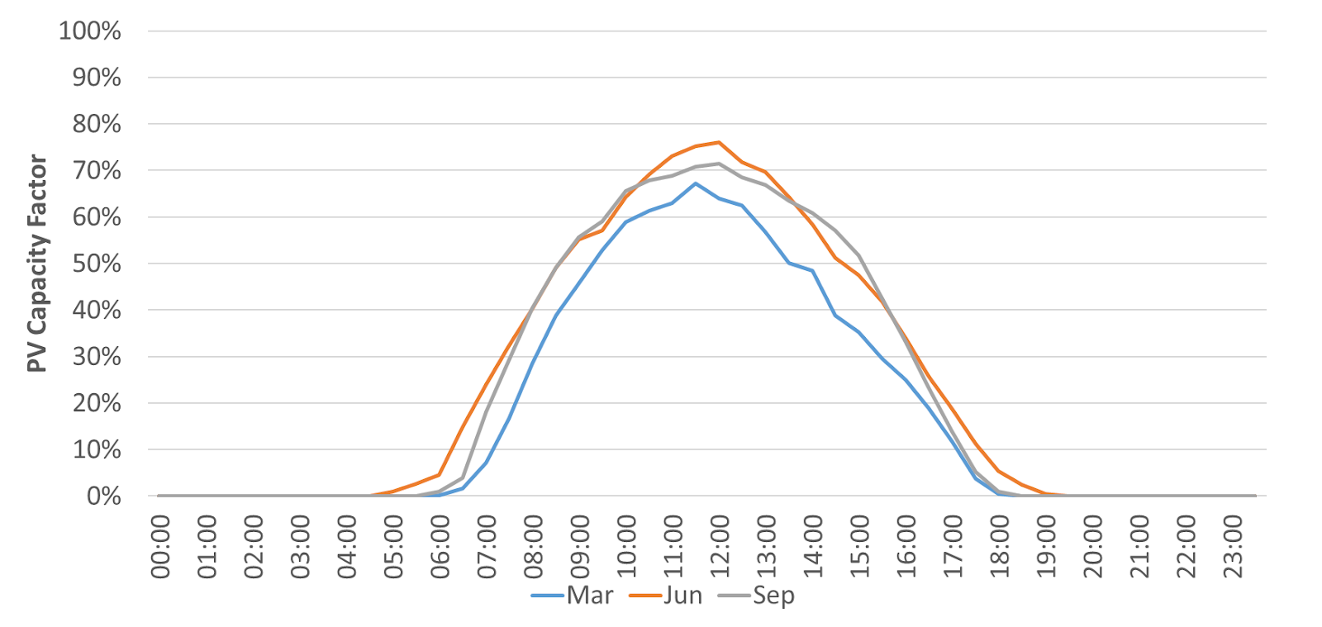
3.2 Additional System Variability
3.2.6 Variability of Renewable Energy Part 2
(Taliotis et al. (2018), image, licensed under CC BY 4.0)
16
Notes:
This diagram exemplifies the variability of renewable energy generation. The Y axis is the solar PV capacity factor, which is essentially a measure of the availability of the PV power plant to generate electricity. Capacity factors are covered in more detail in later lectures. When the capacity factor is 0, this means the PV plant cannot generate any electricity, so this diagram shows that no electricity can be generated from approximately 7:00pm in the evening to 5:00am in the morning. The diagram then shows that the PV capacity factor rises throughout the day and peaks at midday before falling back down to 0 in the evening, tracking the strength of the sunlight. A key message from this diagram is that this PV plant could not be relied upon to produce electricity from approximately 7:00pm to 5:00am, whilst it would be a useful source of generation during the day. We must therefore consider this in energy system modelling, and this is another key reason why we model time variability in OSeMOSYS.

Slide 17
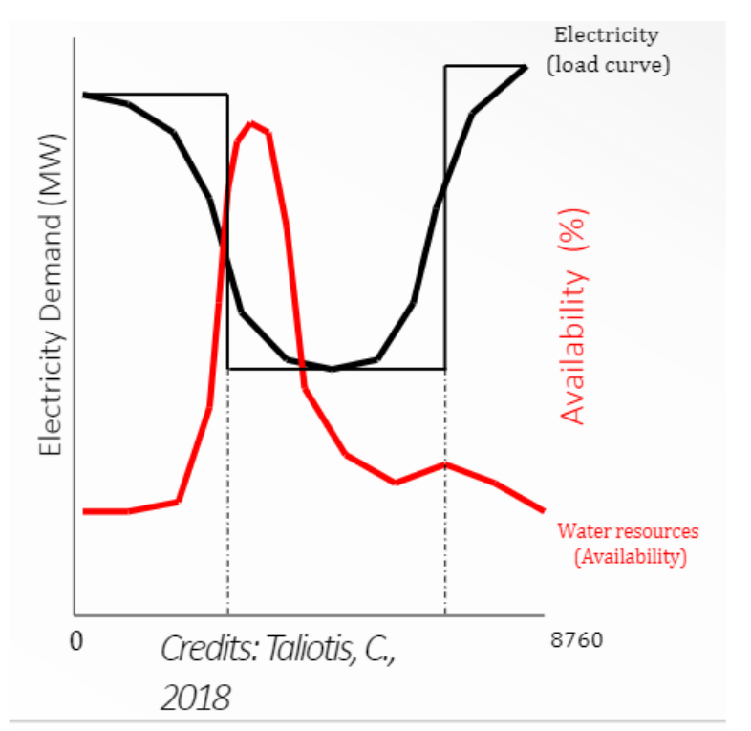
3.2 Additional System Variability
3.2.7 Introduction to the Importance of Flexibility
(Taliotis et al. (2018), image, licensed under CC BY 4.0)
17
Notes:
This graph shows example data on the availability of water resources for producing electricity at hydropower plants and the electricity demand profile. We can see that the peak water availability does not match the peak demand, so demand could not be met using hydropower alone. To ensure demand can always be met, even when there is variability in resource availability as shown on this figure, it is important that the system has sources of flexibility. Flexibility can come from several sources, such as energy storage. Energy storage refers to the idea of storing energy for use at a later time. In electricity systems, it is often helpful to store electricity produced when demand is low, so that the stored electricity can be used when demand is higher and/or less supply is available.
There are several types of energy storage. A common option is pumped storage hydropower, where water is pumped from a lower reservoir to a higher reservoir in order to store power, which is then released when the water is discharged back to the lower reservoir. Electricity systems may also contain standalone batteries, which store electricity from the transmission grid at times of low demand for release when demand is higher, or batteries are commonly combined with renewable energy generation technologies. For example, it is common to have battery storage at solar farms as this allows excess electricity generated during sunny periods to be stored and released when the solar intensity may be lower. Storage and flexibility are covered in more detail in a later lecture.

Slide 18
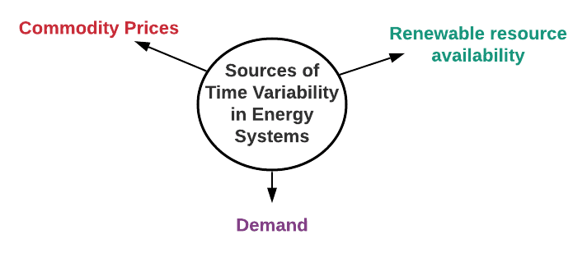
3.2 Additional System Variability
3.2.8 Overall Importance of Modelling Time Variability
18
Notes:
To summarize this and the previous mini-lecture, we have firstly learnt that several elements of energy systems vary over time. These include demand, which varies as power-consuming activities occur at different times of the day and differently in each season, electricity generation, which can vary as renewable resource availability varies over time, and energy prices. We have also seen the importance of balancing electricity supply and demand and the critical impacts that unreliable supply can have. To help mitigate these impacts, we must consider time variability when planning energy systems. This is therefore modelled in OSeMOSYS. The method of modelling time variability in OSeMOSYS is covered in more detail in the next section of this lecture.

Slide 19
Lecture 3.2 References
Taliotis, Constantinos, Gardumi, Francesco, Shivakumar, Abhishek, Sridharan, Vignesh, Ramos, Eunice, Beltramo, Agnese, … Howells, Mark. (2018, November). Time representation in OSeMOSYS. Zenodo. http://doi.org/10.5281/zenodo.4558793
19
19

Slide 20
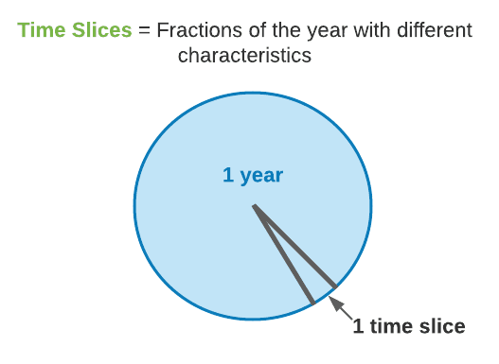
3.3 Time Representation in OSeMOSYS
3.3.1 Introduction to Representing Time Part 1
20
Notes:
In OSeMOSYS we represent time variability by dividing a year into ‘time slices’. Before we talk more about using time slices in OSeMOSYS, it is important to appreciate what we are trying to consider when we use this time slice approach. Time slices are intended to be fractions of the year with different characteristics, typically representing different seasons, different day types, and different times of the day. For example one time slice could represent all the evenings in weekends in summer and another could represent all the evenings in weekends in winter. The ultimate aim of this approach is to capture the variability in demand and resource availability over time in the country we are modelling. This means that the most appropriate definition of time slices may vary by country. For example, some countries have 4 clearly defined seasons, each of which has different weather patterns. For a country like this, we would probably want to ensure each of these seasons was represented by a different time slice in OSeMOSYS, because demand and renewable resource availability will be different in each one. However, other countries only have two seasons which need to be represented, for example countries with only a wet and a dry season.

Slide 21
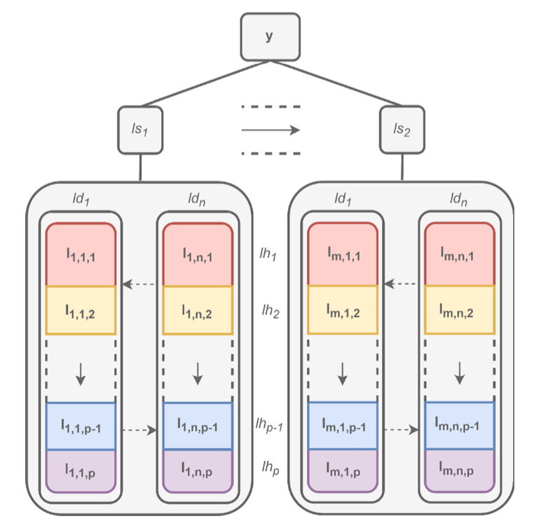
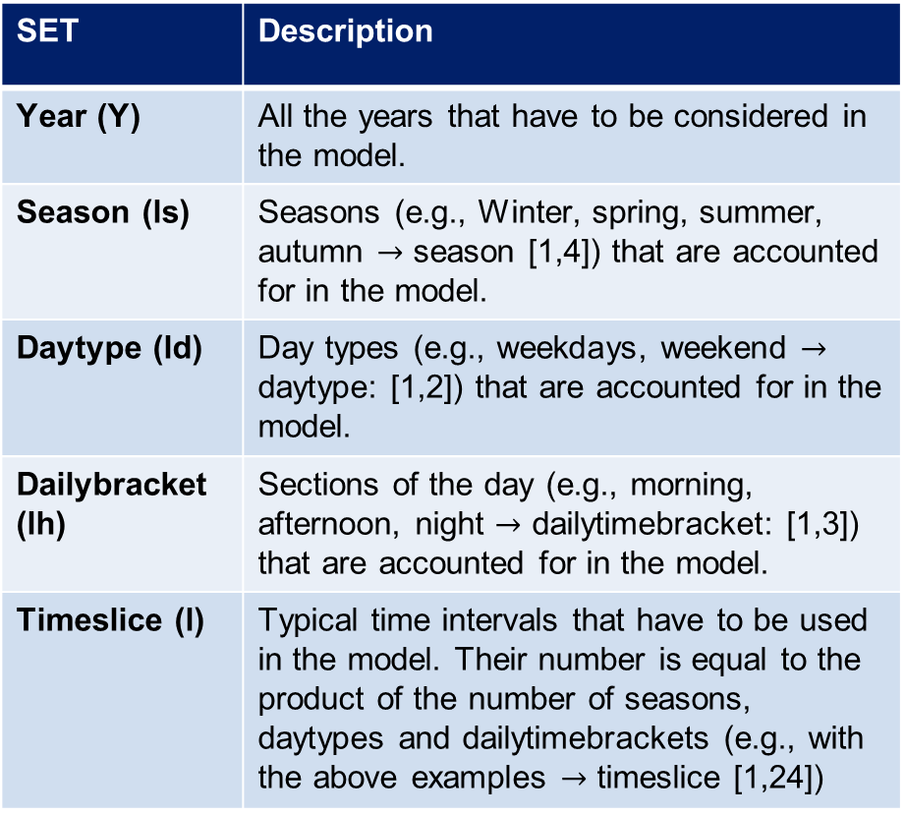
3.3 Time Representation in OSeMOSYS
3.3.2 Introduction to Representing Time Part 2
SET | Description
Year (Y) | All the years that have to be considered in the model.
Season (ls) | Seasons (e.g., Winter, spring, summer, autumn $→$ season [1,4]) that are accounted for in the model.
Daytype (ld) | Day types (e.g., weekdays, weekend $→$ daytype: [1,2]) that are accounted for in the model.
Dailybracket (lh) | Sections of the day (e.g., morning, afternoon, night $→$ dailytimebracket: [1,3]) that are accounted for in the model.
Timeslice (l) | Typical time intervals that have to be used in the model. Their number is equal to the product of the number of seasons, daytypes and dailytimebrackets (e.g., with the above examples $→$ timeslice [1,24])
Novo et al., 2022
21
Notes:
A broader description of how the model divides time into several hierarchical sets is given here:
Year (Y) – This represents all the years within the chosen time horizon of the model.
Season (Is) – Each year is broken down into seasons. For instance, we could divide the year into four seasons: winter, spring, summer, and autumn. This seasonal division helps capture variations in energy needs, like heating in winter or air conditioning in summer.
Daytype (Id) – Within each season, we also differentiate between types of days, such as weekdays and weekends. This allows us to reflect changes in energy consumption patterns, as weekends may have a different demand profile compared to weekdays.
Dailybracket (Ih) – Each daytype is further split into sections of the day, known as daily brackets. Common divisions might include morning, afternoon, and night, helping us capture intraday variations in energy demand and supply.
Timeslice (I) – Finally, these divisions come together to form timeslices. Timeslices are the fundamental time intervals in the model, representing the smallest time unit OSeMOSYS will consider. The number of timeslices is the product of seasons, daytypes, and daily brackets. For example, if we have four seasons, two-day types, and three daily brackets, we end up with 24 timeslices.
On the right side, the diagram visually represents this breakdown, showing how a year is divided into seasons, each season into day types, and each day type into daily brackets, resulting in the final timeslices used for analysis.

Slide 22
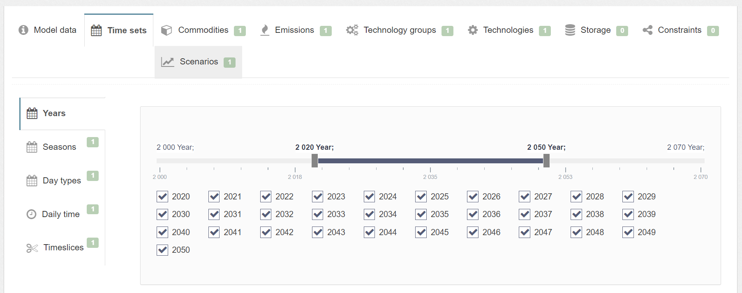
3.3 Time Representation in OSeMOSYS
3.3.3 Time representation in MUIO
In MUIO, we can define timeslices alone if we are not modeling storage technologies. Otherwise, we need to define seasons, day types, and daily time brackets, each of which must be linked to a timeslice.
22
Notes:
In MUIO, we have the flexibility to define different timeslices. On the left, you can see the main time set categories described in the previous slide: Years, Seasons, Day types, Daily timebrackets, and timeslices.
In the timeline view to the right, we see a list of years selected for this example, which span from 2020 to 2050. By selecting specific years, we can customize which periods are analyzed, making the model more efficient.
Importantly, in MUIO, we have the option to define timeslices which are represented through seasons, day types, and daily time brackets which you can also define in the MUIO as highlighted in the image above. This flexibility allows MUIO to adapt time representation based on the model’s specific requirements, ensuring we have the appropriate granularity without unnecessary complexity.

Slide 23
3.3 Time Representation in OSeMOSYS
3.3.4 Year Split
Year Split
Duration of a modelled timeslice, expressed as a fraction of the year. The sum must be equal to 1.
Main Approach
Number of timeslices=Number of seasons times number of daytypes times number dailybrackets For a specific timeslice that represents winter day at 00:00 am - 4:00 am: Based on research on the country you find that: Winter season = 25% of the year (91 days/365 days) Weekdays = 71.4% of the week (5 days/7 days ) 00:00-4:00 am = 16.7% (4 hours/24hours) Then the year split value for this timeslice will be 25%*71.4%*16.7% = 0.0298
23
Notes:
The Year Split is the proportion of the year represented by each timeslice. It’s important to check that Year Split values sum to 1. Typically, we have a precise definition of each timeslice which enables us to estimate the Year Split value. For example, for a specific country, if the winter season makes up 25% of the year (91 days/365 days), the weekdays make up 71.4% of the week (5 days/7 days), and we want to represent a 4-hour interval which is 16.7% of a day (4 hours/24 hours), then the year split value for this timeslice will be 25%*71.4%*16.7% = 0.0298. You would then enter this value for the year split parameter for this specific timeslice for all years. A similar exercise is given in Hands-On Exercise 2.

Slide 24

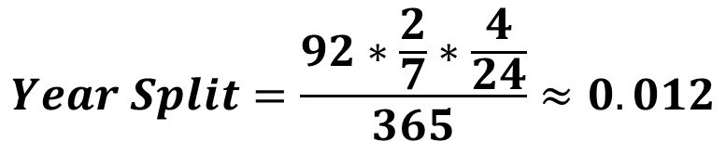
3.3 Time Representation in OSeMOSYS
3.3.5 Year Split Exercise
A timeslice is defined as:
Season 3: June, July, August
Daytype: weekends
Dailytimebracket: 2:00 PM to 6:00 PM
What is the value of the YearSplit for this timeslice?
$$Number of days in season 3=30 \left(June\right)+31 \left(July\right)+31 \left(August\right)=92$$
$$Proportion of days in weekends=\frac{2}{7}$$
$$Proportion of hours 2:00 to 6:00 PM in 1 day=\frac{4}{24}$$
$$Year Split=\frac{92∗\frac{2}{7}∗\frac{4}{24}}{365}≈0.012$$
24
Notes:
This is a second example of how to calculate the Year Split once the timeslice features are defined. In this case, a season covering June through August consists of 92 days (30 in June, 31 in July, and 31 in August). If we consider only weekends (i.e., 2 out of 7 days) and a daily time bracket from 2 PM to 6 PM (i.e., 4 out of 24 hours), the Year Split is the product of these ratios divided by the 365 days in a year, as shown on the slide.

Slide 25
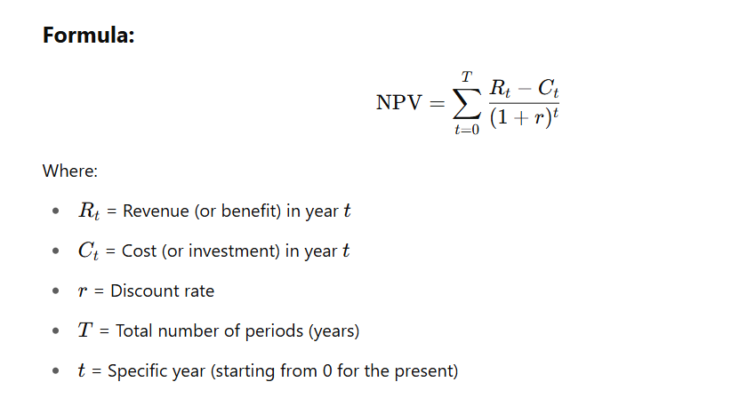
3.3 Time Representation in OSeMOSYS
3.3.6 Additional Parameters: Net Present Value
It is a financial metric used to evaluate the profitability of an investment or project by calculating the present value of all expected future cash flows—both incoming and outgoing—discounted back to the present using a specified discount rate.
Net Present Value
25
Notes:
This slide introduces the concept of Net Present Value (NPV), a key financial indicator used to evaluate the economic viability of energy investments over time. NPV represents the sum of all future cash flows—revenues and costs—discounted to their present value using a chosen discount rate (i.e. it tells you how much everything costs during your modelling horizon in terms of the value of money in present day). The time value of money is the concept that a unit of money today is worth more than the same amount in the future because of its potential earning capacity—that is, money available now can be invested, generate returns (such as interest or profits), or be used to avoid borrowing costs. Over time, the purchasing power of money can also change due to inflation.
This principle is crucial in energy system modelling, especially when comparing future investments, costs, or benefits. By applying Net Present Value (NPV), all future cash flows are adjusted (or discounted) to reflect their present-day value, ensuring a fair and consistent comparison across time. Without accounting for the time value of money, long-term projects might appear more (or less) attractive than they truly are, leading to poor investment or policy decisions.
In the context of OSeMOSYS, NPV is central to cost optimization. The model minimizes the total system cost over the entire planning horizon by calculating the present value of investment, operation, and maintenance costs. This allows users to compare long-term energy strategies on a consistent economic basis, accounting for the time value of money.

Slide 26
3.3 Time Representation in OSeMOSYS
3.3.7 Additional Parameters: Discount Rates
Global discount rate or social discount rate (SDR) to account for public investments. SDR is the expected return from a central planner perspective. Used to calculate the net present value of costs in the model.
Decimal value between 0 and 1
Discount rate
Individual discount rates or hurdle rates (HR) for every single generation technology. In other words, HR is the expected return from an investor perspective. Used to calculate an annualized cost of capital.
Decimal value between 0 and 1
Discount rate Idv
Potential sources: National energy planning assessments, National bank reports
26
Notes:
In the final slide of this lecture, we will briefly introduce two parameters used in setting up a model in OSeMOSYS, which we’ll practice using in Hands-On Exercise 2. While we don’t need to study discounting in depth for this course, we’ll provide a quick explanation of how it is applied in OSeMOSYS. The purpose of discounting is to account for the time value of money, where it is generally more advantageous to have a given amount now rather than in the future. For example, if given the choice between receiving $100 now or in two years, it is more beneficial to have it now since it could be invested to grow beyond $100 over two years. This concept is captured by the Discount Rate, which is used to determine the present value of future cash flows. In OSeMOSYS, the Discount Rate parameter, represented as a decimal, serves this purpose. A typical discount rate might be 10%, which we represent in OSeMOSYS with a value of 0.1 for the Discount Rate parameter. Additionally, individual discount rates can be defined for each technology to calculate the annualized capital cost.

Slide 27
Lecture 3.3 References
Taliotis, Constantinos, Gardumi, Francesco, Shivakumar, Abhishek, Sridharan, Vignesh, Ramos, Eunice, Beltramo, Agnese, … Howells, Mark. (2018, November). Time representation in OSeMOSYS. Zenodo. http://doi.org/10.5281/zenodo.4558793
27

Slide 28
Thank you
Consolidated by:
Fernando Plazas-Niño, Kane Alexander, Hannah Luscombe, Lucy Allington, Carla Cannone, Pooya Hoseinpoori, Alexander Kell, Adam Hawkes, Mark Howells
www.climatecompatiblegrowth.com

